Slide 1


<Andrew Srb>
<9/27/2025>

Slide 2

Outline
Executive Summary
Introduction
Methodology
Results
Conclusion
Appendix

Slide 3
Executive Summary
Analyze SpaceX launch records to identify success patterns, payload correlations, and booster performance.
Data collection via SpaceX REST API , Interactive dashboard, and Predictive modeling.
Real-time insights for mission planning and strategic decision-making.
Conclusions from predictive analysis find that there’s and ~87% chance of accuracy

Slide 4
Introduction
What Determines a Successful Landing?
Key Factors We Investigated:
Payload Size – How the weight of the mission cargo influences landing outcomes
Booster Version – Differences in reliability across Falcon 9 variants
Launch Details – Timing, mission type, and mission complexity
Launch Location – Impact of site conditions (Cape Canaveral, Vandenberg, Kennedy)
Launch Distance – Orbital destination and mission trajectory
Landing Location – Ground pad vs. drone ship recovery

Slide 5

Section 1

Slide 6
Methodology
Executive Summary
Data collection methodology:
API pulls and web scraping from trusted public sources
Perform data wrangling
Launch details, orbit distance, and outcome classification
Perform exploratory data analysis (EDA) using visualization and SQL
Perform interactive visual analytics using Folium and Plotly Dash
Perform predictive analysis using classification models
Trained and tested the data set utilizing LogisticalRegression, KNN, Decision Trees, and SVM

Slide 7
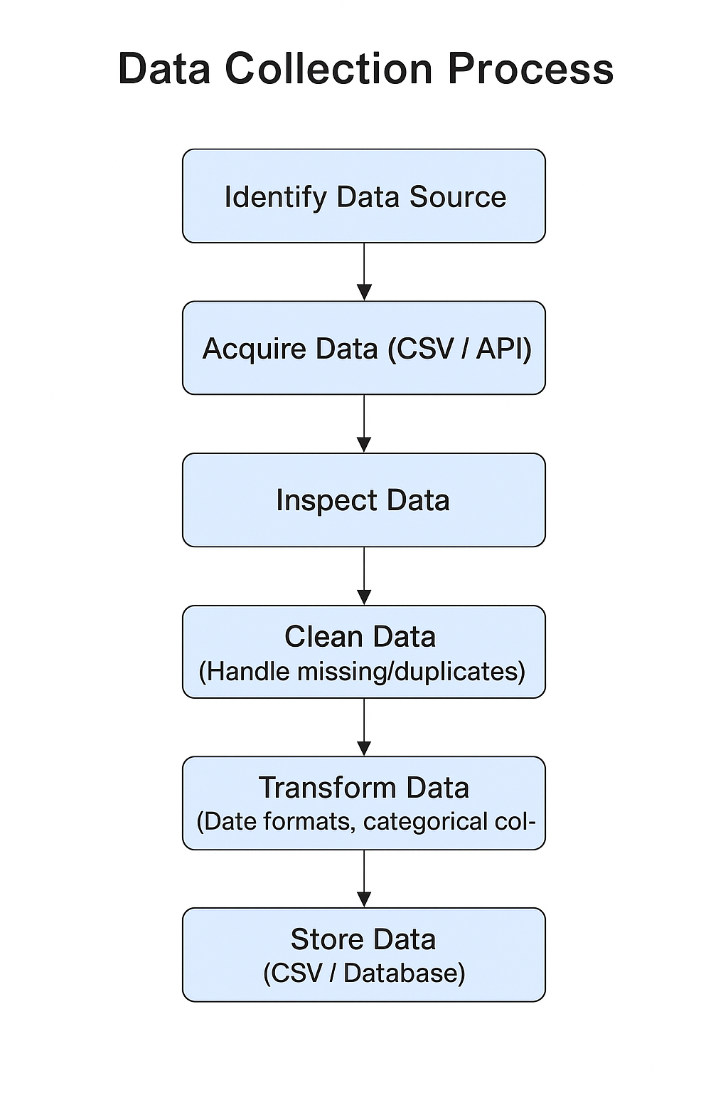
Data Collection
Source Identification: Identify reliable data sources (e.g., public SpaceX launch datasets, Kaggle, APIs).
Data Acquisition: Download CSV files or query APIs to gather structured launch data.
Data Inspection: Check column names, data types, and completeness.
Data Cleaning: Handle missing values, duplicates, and inconsistent formats.
Data Transformation: Convert dates to standard formats, categorize outcomes (success/failure).
Data Storage: Save the cleaned dataset in CSV or database for further analysis.

Slide 8
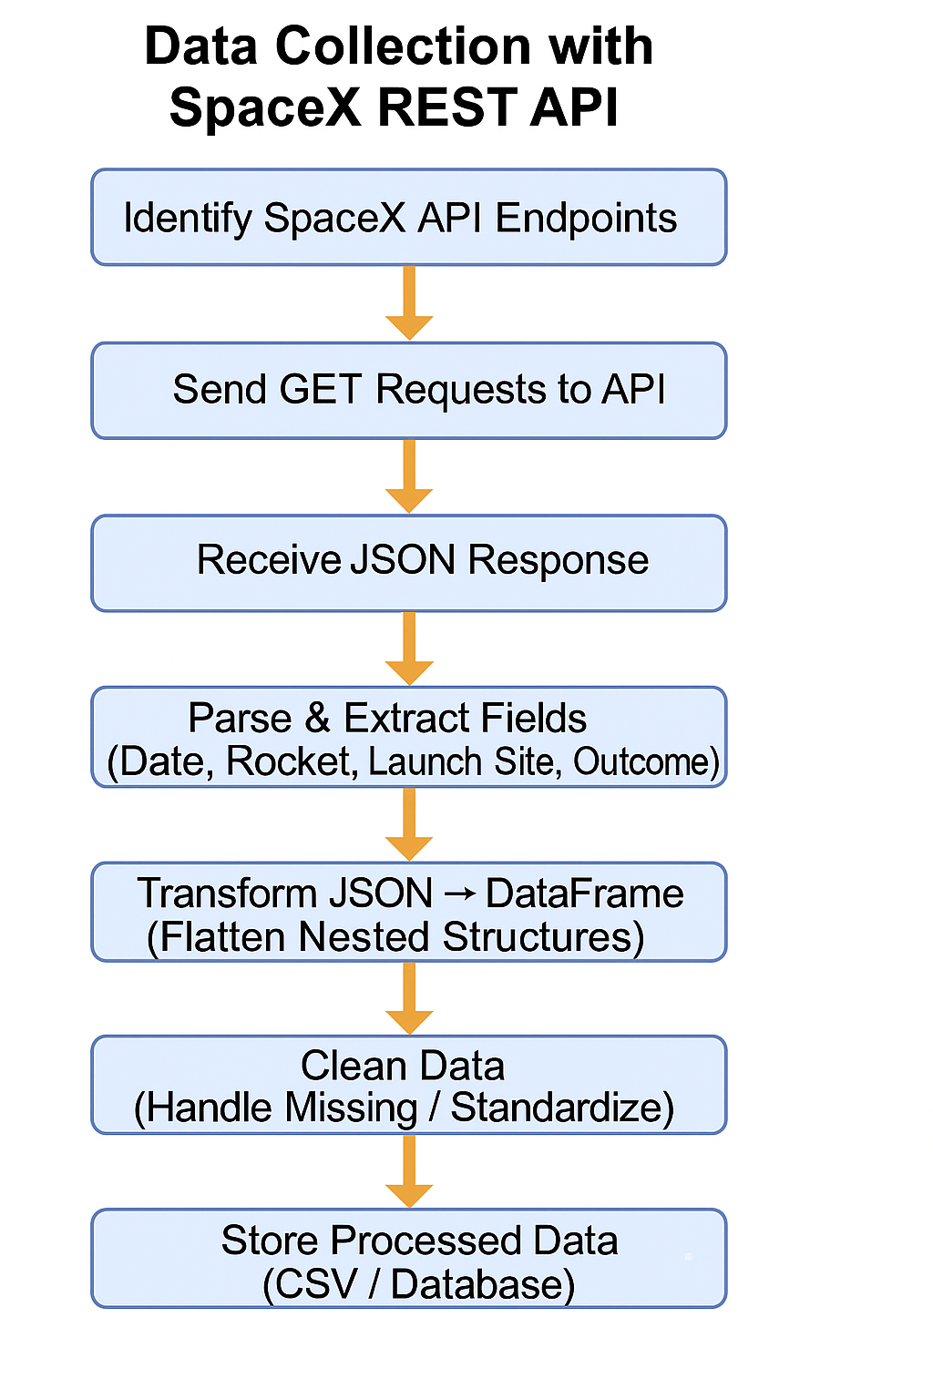
Data Collection – SpaceX API
Identify API Endpoints
Parse & Extract Fields
Important attributes: date_utc, rocket, launchpad, payloads, success
Clean Data
Handle missing values (e.g., payload mass for failed missions)
Standardize outcomes (success → 1, failure → 0)
Normalize categorical values
GitHub link

Slide 9
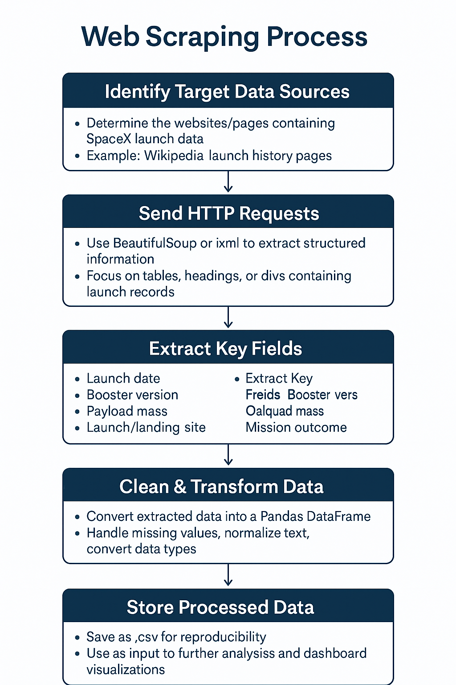
Data Collection - Scraping
Identify Target Data Source
Select websites containing SpaceX launch data (e.g., Wikipedia)
Extract Key Fields
Launch date, booster version, payload mass, launch site, outcome
Clean & Transform Data
Handle missing values, normalize text, standardize formats
Store Processed Data
GitHub Link

Slide 10
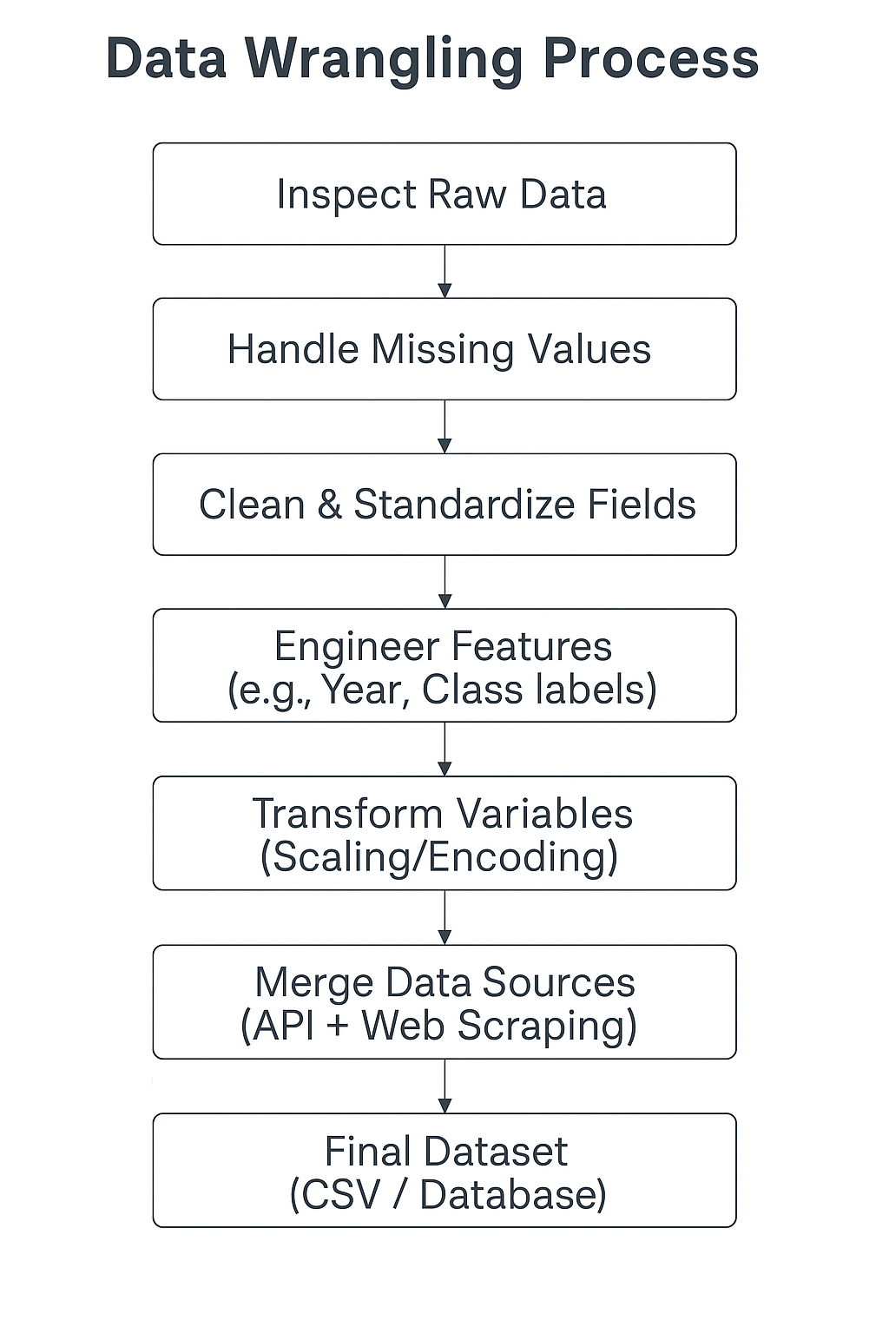
Data Wrangling
Data Inspection – Checked dataset structure, column names, and data types
Handling Missing Values – Filled or removed incomplete rows (e.g., payload mass missing for failed launches)
Data Cleaning – Standardized categorical variables (success/failure → 1/0, booster versions normalized)
Feature Engineering – Extracted year from launch date, derived launch outcome labels, and created numerical encodings for categorical fields
Data Transformation – Scaled payloads and continuous variables with StandardScaler
Data Integration – Merged API, web-scraped, and cleaned data into one consistent DataFrame
Final Storage – Saved clean dataset into .csv for analysis and dashboard use
GitHub Link

Slide 11
EDA with Data Visualization
Bar Charts - Compare success rates across orbit types
Line Charts - Track success rate trends over time (by year)
Scatter Plots - Visualize relationship between payload & outcomes, color-coded by booster version
GitHub Link

Slide 12
EDA with SQL
Filter: Launch sites starting with 'CCA'
Aggregate:
Total payload mass by NASA (CRS)
Average payload mass for F9 v1.1
Date: First successful ground pad landing
Conditional: Boosters with successful drone ship landings & payload 4000–6000
Counts: Successful vs failed mission outcomes
Subquery: Booster versions with maximum payload mass
Year/Month: Drone ship landing failures in 2015
Ranking: Landing outcomes ranked (2010–2017)
GitHub Link

Slide 13
Build an Interactive Map with Folium
Markers - Identify launch sites & coastline points
Circles - Show launch site boundaries (1 km radius)
Lines - Connect sites to coastlines/cities, show distances
DivIcon Labels - Display site names & distances directly on map
GitHub Link

Slide 14
Build a Dashboard with Plotly Dash
Pie Chart - Shows success vs. failure (per site or all sites)
Why: Easy way to compare proportions at a glance
Scatter Plot - Plots payload vs. outcome, color-coded by booster version
Why: Reveals correlations between payload size and success, and booster performance differences
Interactions:
Dropdown (Launch Site): Filter visualizations by site or view all sites
Range Slider (Payload): Filter results by payload size range
Github Link

Slide 15
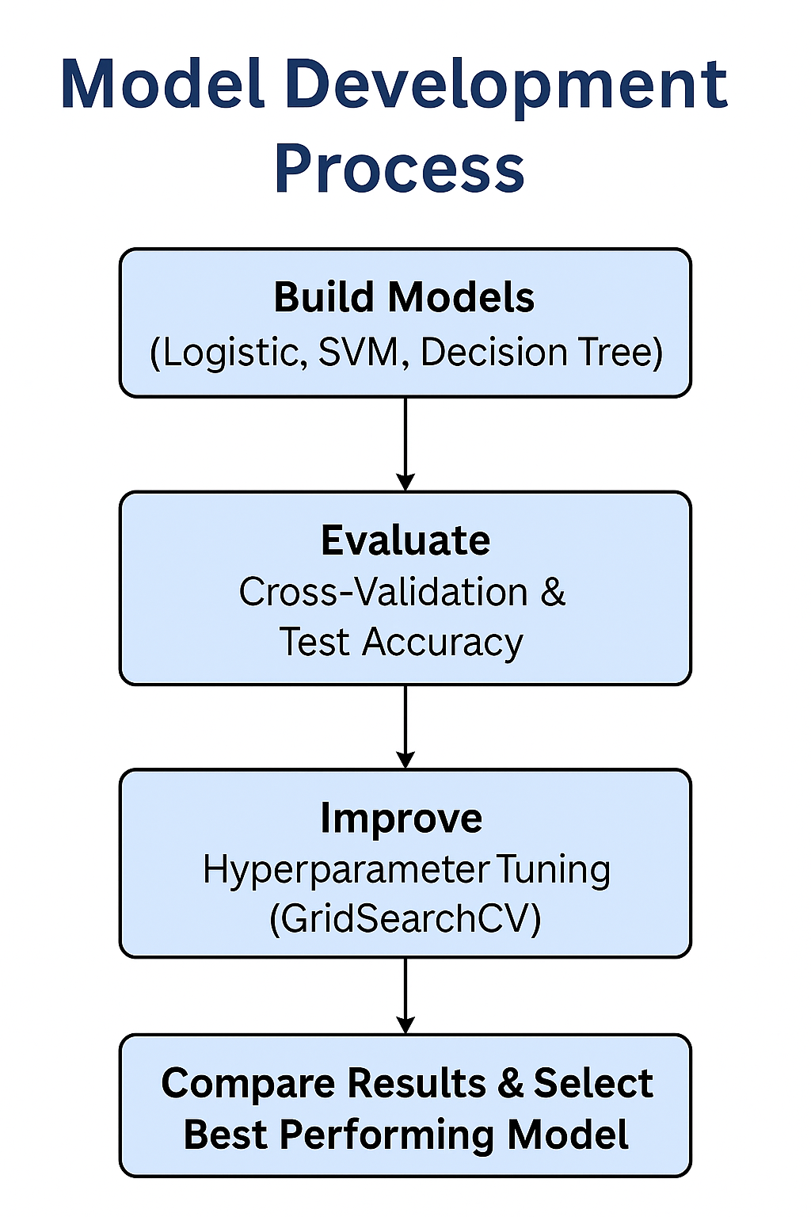
Predictive Analysis (Classification)
Build: Trained multiple classifiers (Logistic Regression, SVM, Decision Tree, KNN)
Evaluate: Used cross-validation (cv=10) and accuracy score on test set
Improve: Performed hyperparameter tuning with GridSearchCV
Select Best: Compared test accuracies, identified Decision Tree as best performer (~87%)
GitHub Link

Slide 16
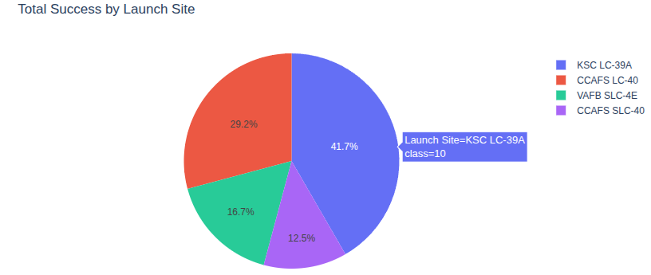
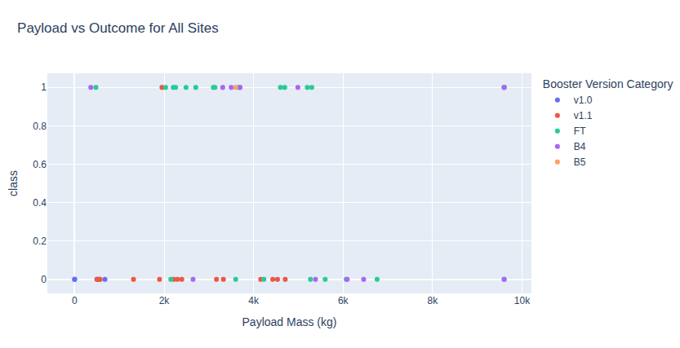
Results
KSC LC-39A consistently had higher success rates
Scatter plots revealed heavier payloads (2k-4k) sometimes linked to higher failure probability
Booster version FT also influenced outcomes
Bar charts highlighted variation in success depending on orbit type (LEO vs GTO, etc.)
Line charts showed increasing success rates year over year, improving reliability
Folium maps confirmed all launch sites are near coastlines
Distances to landing locations were important for mission recovery planning
Models Tested: Logistic Regression, SVM, Decision Tree, KNN
Evaluation Method: 10-fold cross-validation + accuracy on test set
Best Performing Model: Decision Tree Classifier (~87% accuracy) - Outperformed others by capturing strong categorical relationships (launch site, booster version)
Other Models:SVM & KNN ≈ 85%, Logistic Regression ≈ 84%
Key Insight:
Launch outcome is highly influenced by site, booster type, and payload range
Predictive modeling shows reliable accuracy for future mission outcomes

Slide 17

Section 2

Slide 18
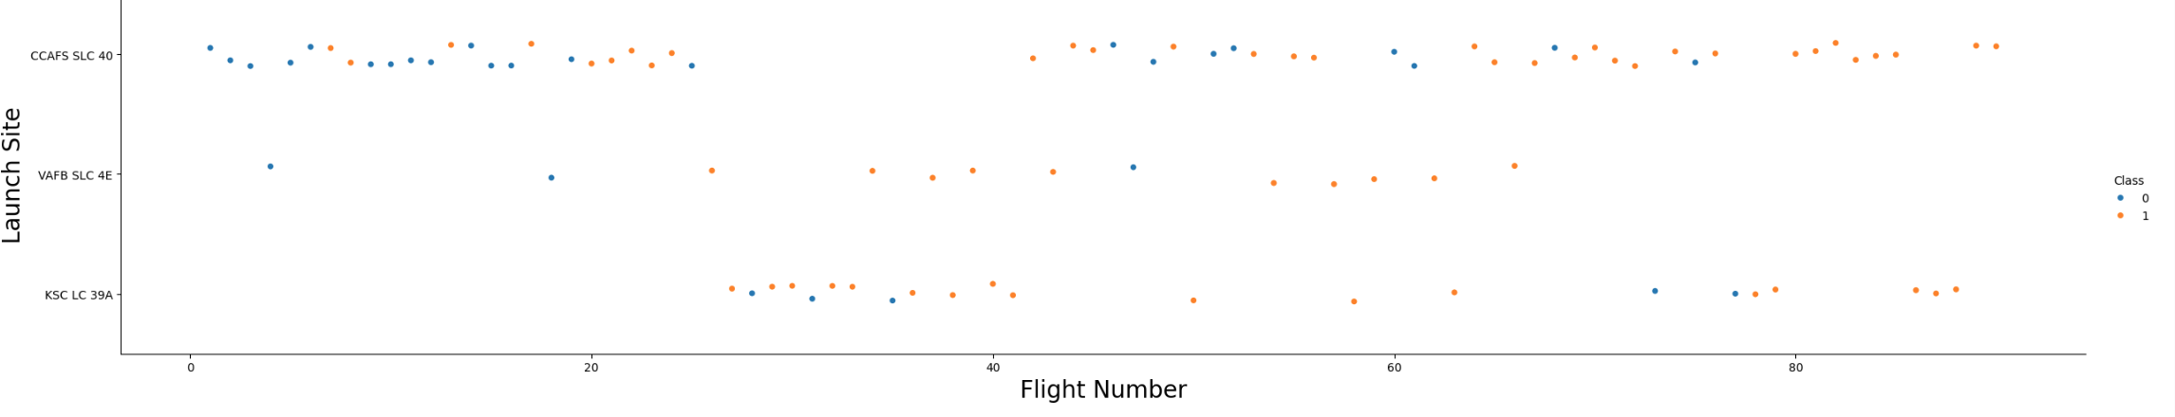
Flight Number vs. Launch Site
Early launches concentrated in a few sites (e.g., CCAFS LC-40).
Over time, more sites were added (KSC LC-39A, VAFB SLC-4E), shown by points appearing at new Y-axis categories.
The scatter pattern shows SpaceX increasing launch cadence while diversifying across multiple sites.
Success rates improved as flight numbers increased, across different sites.

Slide 19
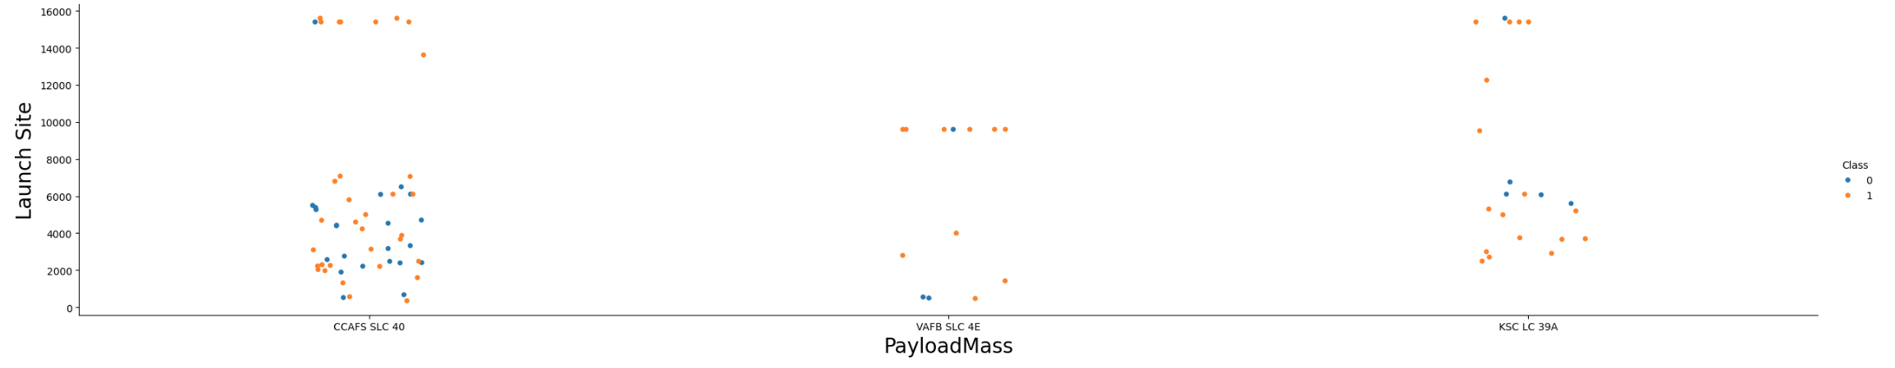
Payload vs. Launch Site
Variation by site: Some launch sites consistently supported larger payloads (e.g., Kennedy LC-39A), while others handled smaller or medium payloads.
Success patterns: Heavier payloads showed slightly lower success probability at certain sites (especially early missions).
Operational strategy: The plot shows how SpaceX assigns missions strategically, with certain launch pads dedicated to high-capacity missions.

Slide 20
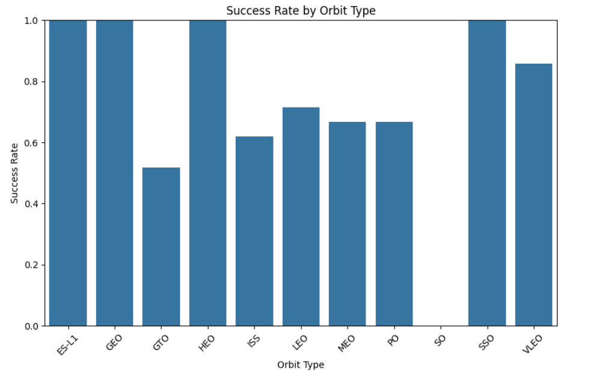
Success Rate vs. Orbit Type
Higher Success in Common Orbits:
Missions to LEO (Low Earth Orbit) and ISS resupply (NASA CRS) had the highest success rates, reflecting routine, well-optimized missions.
Lower Success in Complex Orbits:
Launches to GTO (Geostationary Transfer Orbit) and Polar orbits had lower success rates, due to heavier payloads and more complex trajectories.
Operational Learning Curve:
Early missions to advanced orbits had more failures, but the chart shows improvement over time, as experience and technology matured.

Slide 21
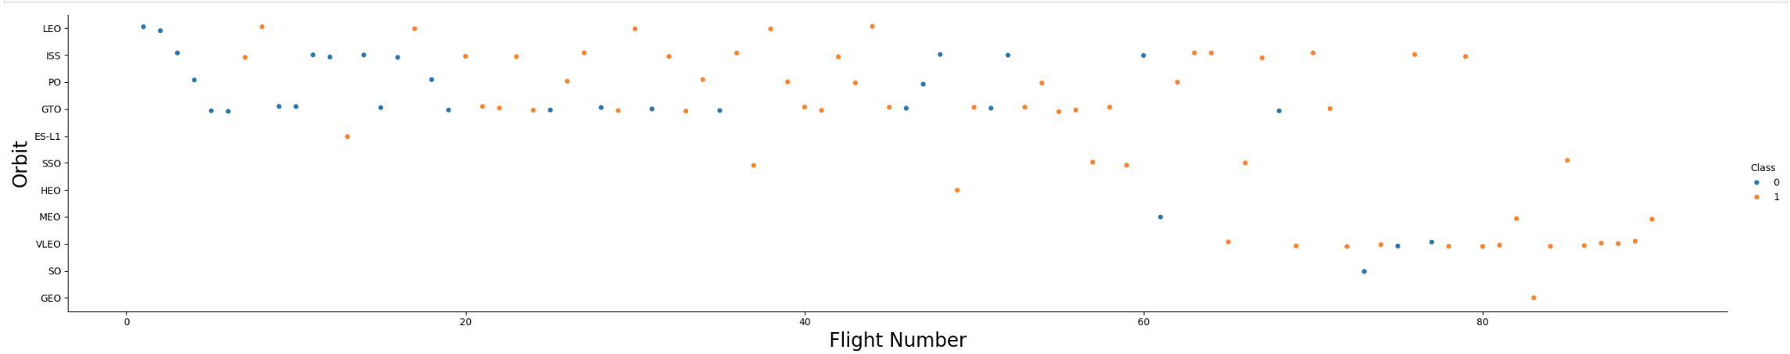
Flight Number vs. Orbit Type
Expansion of Mission Types:
Early flights (low flight numbers) were mostly LEO missions, indicating simpler, short-distance launches during SpaceX’s learning phase.
As flight numbers increased, more orbit types appeared (e.g., GTO, Polar), showing diversification of capabilities.
Improving Reliability Over Time:
Early missions to new orbits had mixed success rates.
Later missions in the same orbit types showed higher success consistency, reflecting improved technology and operational experience.
Orbit-Specific Patterns:
ISS/LEO missions show consistently high success once operational maturity was reached.
GTO and Polar orbits initially displayed lower reliability but improved over time.

Slide 22
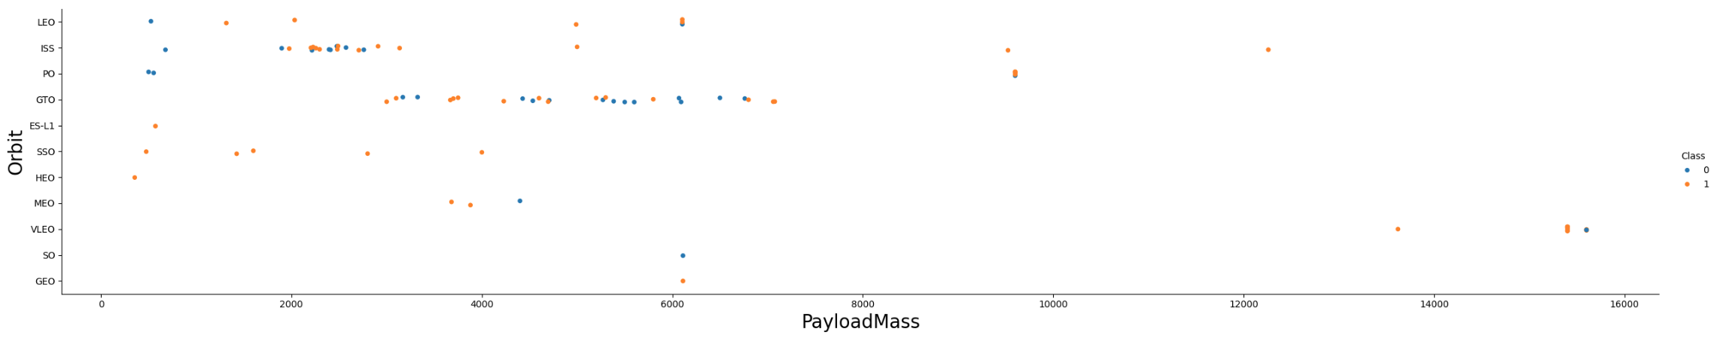
Payload vs. Orbit Type
LEO & ISS Missions:
Typically carried lighter to medium payloads.
Very high success rate once operational maturity was achieved.
GTO Missions:
Concentrated in the heavier payload range.
Showed higher risk/failure rate in earlier flights but improved over time.
Polar & Other Orbits:
Payloads were in a broad middle range.
Fewer launches overall, making them less common but strategically important.
General Pattern:
As payload mass increased, missions were more likely associated with complex orbits (GTO, Polar).
Success rates improved with experience and booster evolution, even for heavy payload missions.

Slide 23
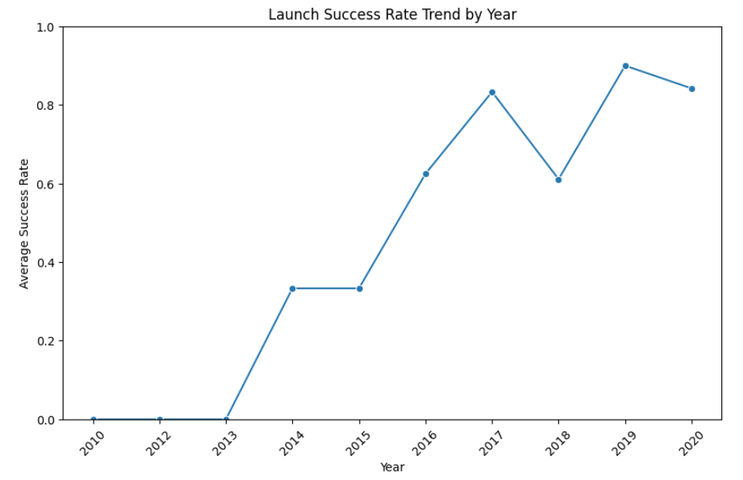
Launch Success Yearly Trend
Early Years (2010–2013):
Success rate was low and inconsistent
Reflected SpaceX’s testing and early operational learning curve
Mid-Years (2014–2016):
Noticeable improvement in reliability
More frequent successes, fewer mission failures
Recent Years (2017 onward):
Success rate reached consistently high levels (approaching 1.0)
Demonstrated maturity of Falcon 9 reusability and operations
Overall Trend:
Clear upward trajectory in success rate over time
Shows continuous innovation and learning leading to operational excellence

Slide 24
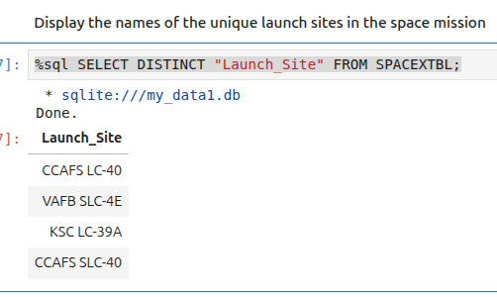
All Launch Site Names

Slide 25
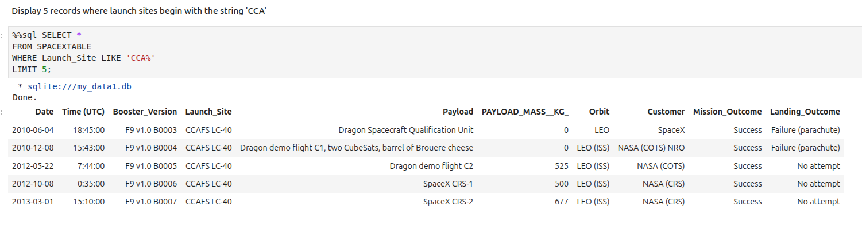
Launch Site Names Begin with 'CCA'

Slide 26
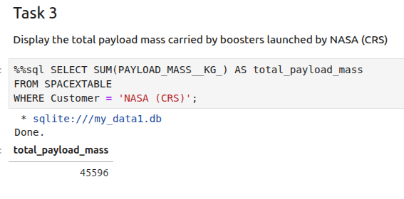
Total Payload Mass

Slide 27
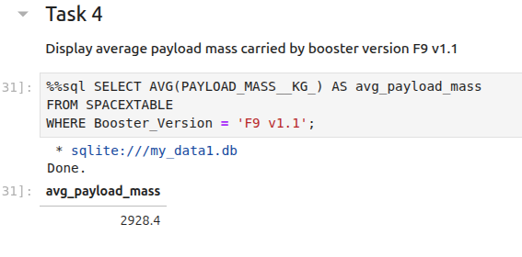
Average Payload Mass by F9 v1.1

Slide 28
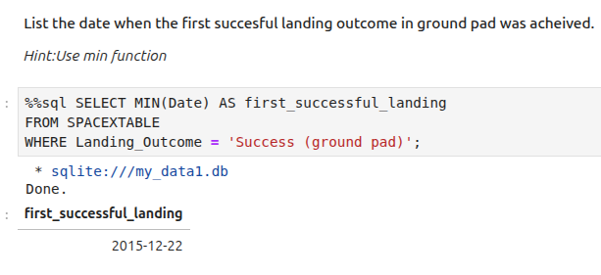
First Successful Ground Landing Date

Slide 29
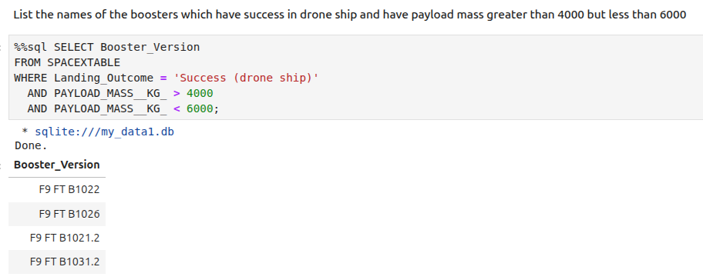
Successful Drone Ship Landing with Payload between 4000 and 6000

Slide 30
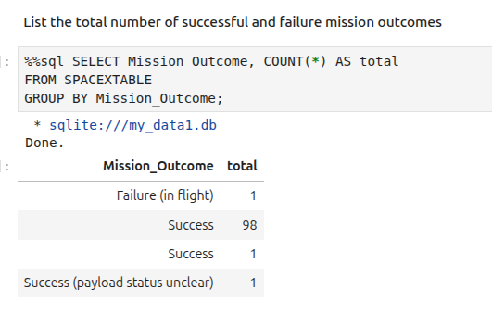
Total Number of Successful and Failure Mission Outcomes

Slide 31
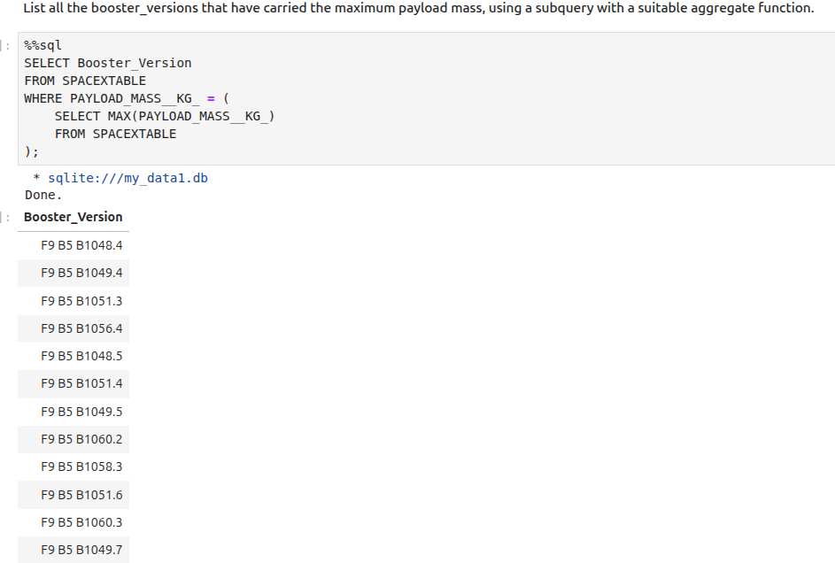
Boosters Carried Maximum Payload

Slide 32
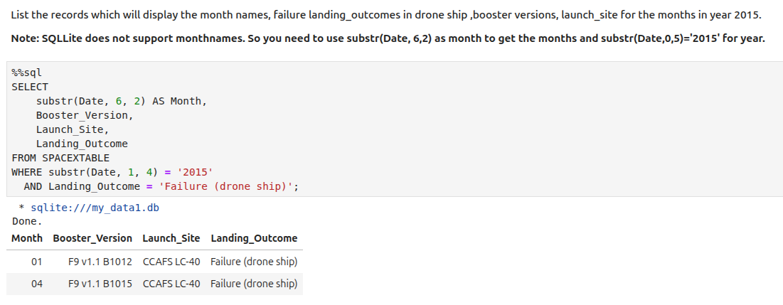
2015 Launch Records

Slide 33
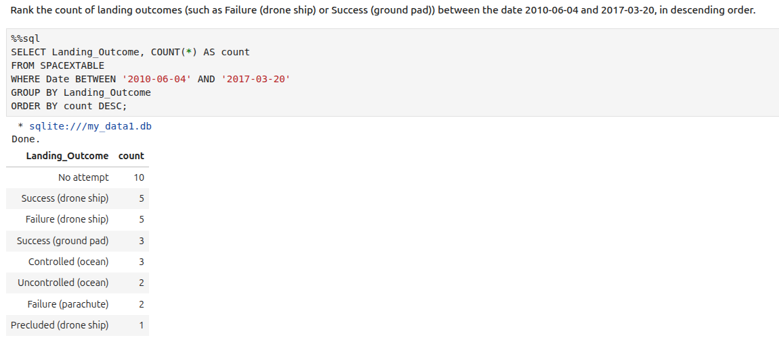
Rank Landing Outcomes Between 2010-06-04 and 2017-03-20

Slide 34

Section 3

Slide 35
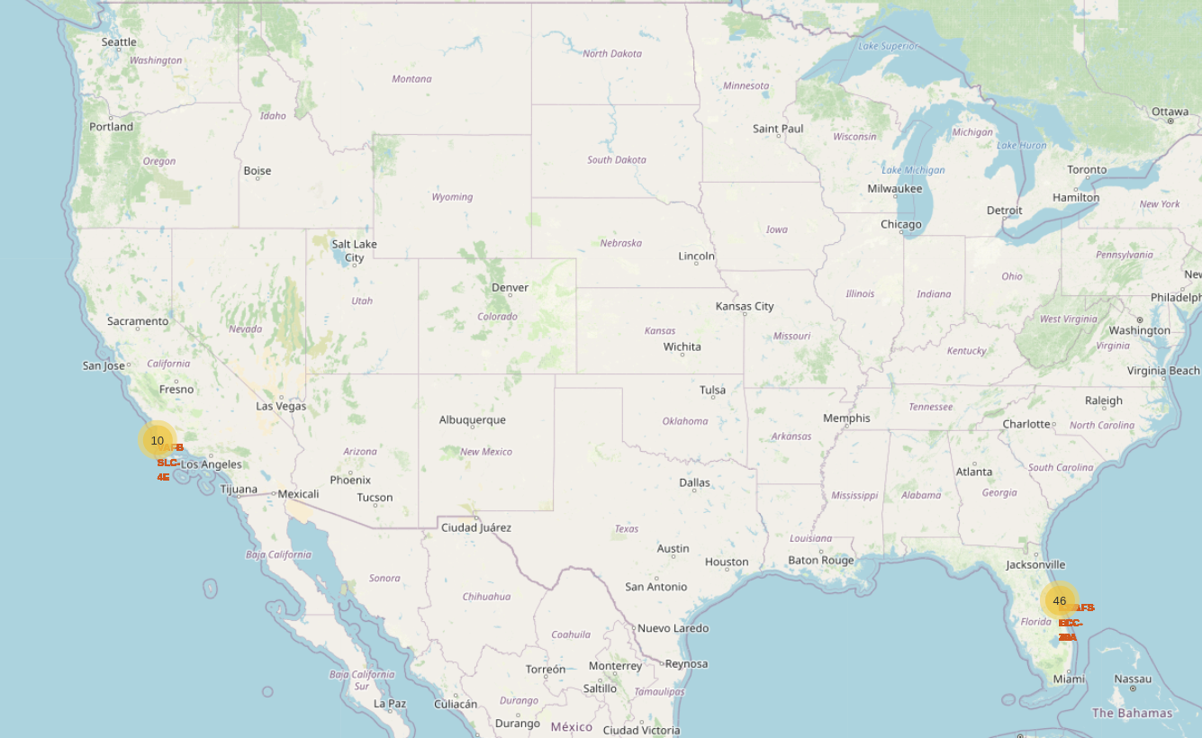
Folium Launch Site Map
Space X primarily launched from the east coast.

Slide 36
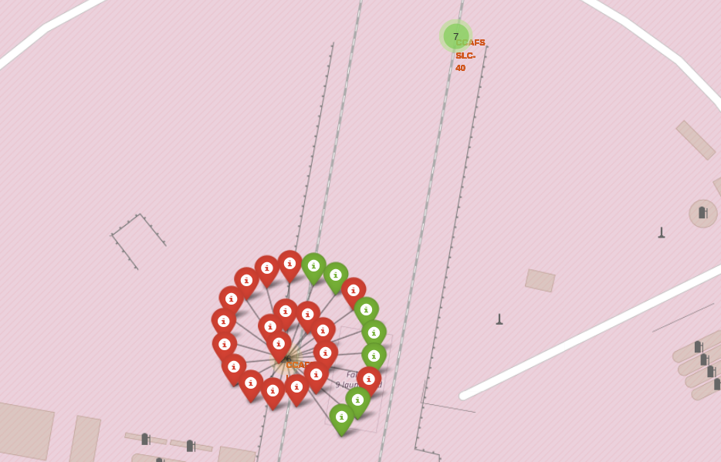
Folium Launch Outcome Map
Each launch marker expands to show the number of successful (green) and unsuccessful (red) launches at a given site.

Slide 37
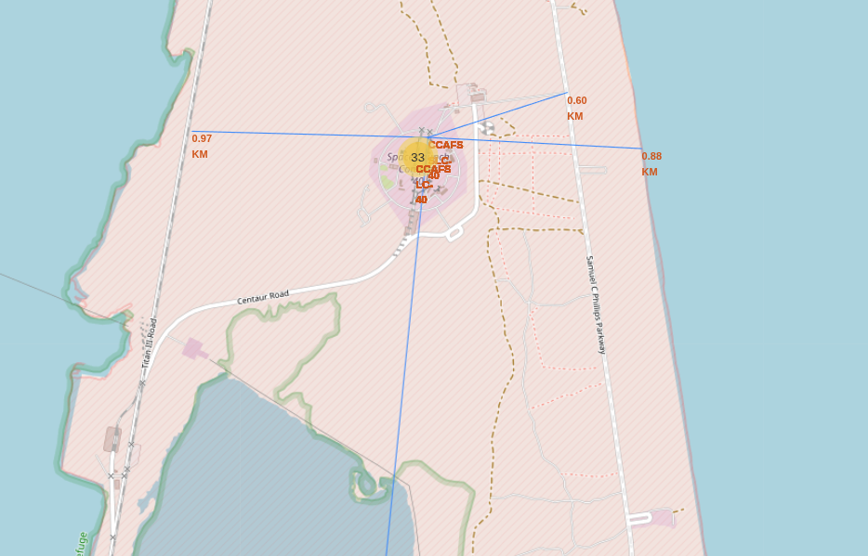
Folium Launch Site Proximity Map
Launch sites have close proximity to coast lines and supporting infrastructure, such as railroads and highways, while maintaining a minimum 15km distance from cities.

Slide 38

Section 4

Slide 39
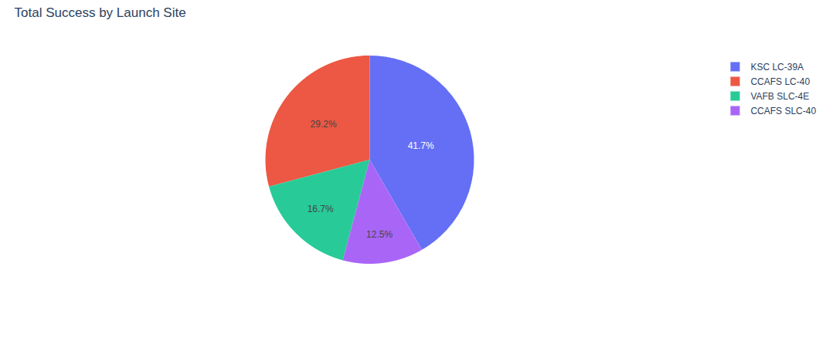
Total Success by Launch Site
Most successful launches originated from KSC LC-39A

Slide 40
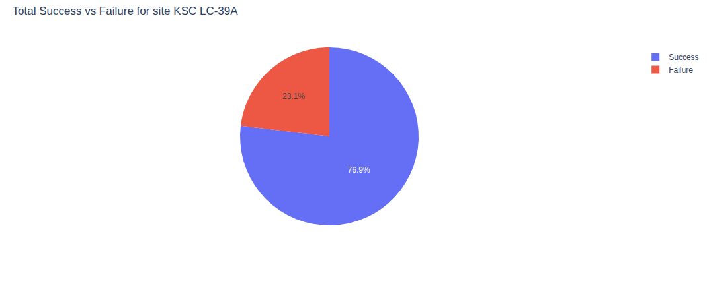
Total Success vs. Failure of KSC LC-39A
KSC LC39A had a 76.9% Success rate and 23.1% Failure rate.

Slide 41
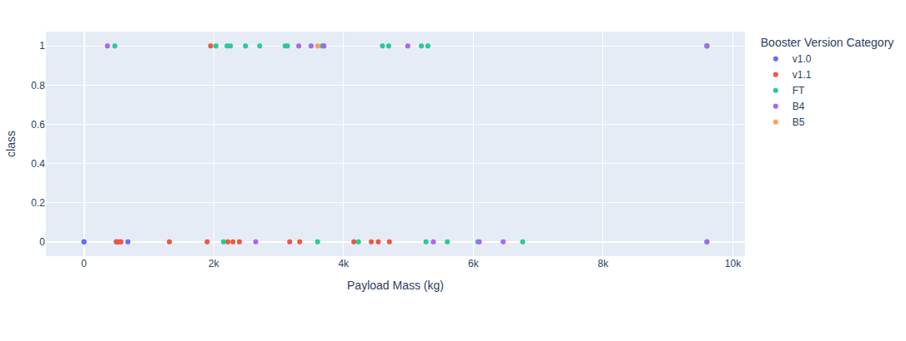
Payload Outcome for All Sites
The most successful payload range was between 2000 kg – 4000 kg.
The most failures for a payload range was between 4000 kg – 7000 kg.
The FT Booster Version was the most successful booster.

Slide 42

Section 5

Slide 43
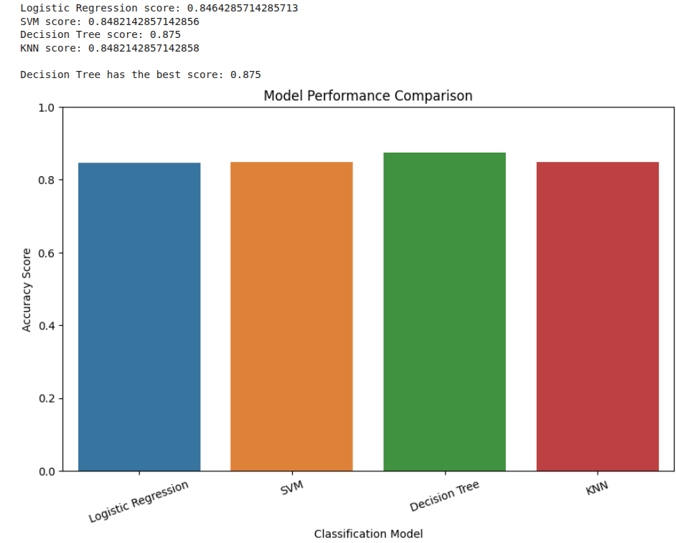
Classification Accuracy

Slide 44
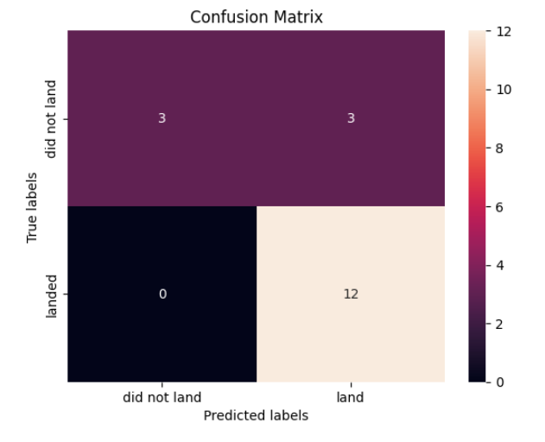
Confusion Matrix
The Decision Tree model not only had the highest accuracy (~87%), but its confusion matrix confirmed that it predicts both successes and failures reliably, with only a small number of missed classifications. This balance makes it the strongest candidate for forecasting future mission outcomes.

Slide 45
Conclusions
Comprehensive Analysis
Collected, cleaned, and integrated SpaceX data from API & web scraping
Built interactive dashboard for exploratory insights
Key Findings
Launch success varies by site, payload, orbit, and booster version
Success rates have steadily improved year over year
Geospatial context highlights importance of site and landing location
Predictive Modeling
Tested multiple ML models with cross-validation
Decision Tree achieved best performance (~87% accuracy)
Confusion matrix confirmed strong reliability in predicting outcomes
Impact
Provides both historical insights and a predictive framework
Supports better understanding of what drives successful launches

Slide 46
Appendix
GitHub link to the entire repository.

Slide 47


